Slide 1
GEE CODING PROJECT
Group - 24
MS3001D
Engineering Economics

Slide 2
INTRODUCTION
We use statistical analysis on Environmental data to interpret the increasing flood of vast data from environmental areas, which are often of heterogeneous nature and show high variability. We analyze the data collected for many years to notice the significant effects on the environment. Many important results and statements concerning our environment are based on statistical investigations, such as changes of the ozone layer, climate changes etc.

Slide 3
PROBLEM STATEMENT
With the exponential increase in technology, production and population in the recent years, these impacts on the environment are more significant then ever before. In this post industrial revolution era, to meet the ever-increasing needs of the population, huge industries are set up leading to release of enormous amount of greenhouse gases and non-renewable resources are exploited. We are now in a stage where we can literally taste the climate change.
Though some nations are focusing on curbing deforestation and boosting renewable energy sources, but it takes many years for the whole world to properly implement that considering different status of development in different countries.
At stake are hundreds of millions of lives, innumerable species and ecosystems, the health and viability of the economy, and the future habitability of this planet.

Slide 4
DATASET
MOD13A2.006 Terra Vegetation Indices 16-Day Global 1km
Variables: NDVI, EVI
The MOD13A2 V6 product provides two Vegetation Indices (VI): the Normalized Difference Vegetation Index (NDVI) and the Enhanced Vegetation Index (EVI). The NDVI is referred to as the continuity index to the existing National Oceanic and Atmospheric Administration-Advanced Very High Resolution Radiometer (NOAA-AVHRR) derived NDVI. The EVI has improved sensitivity over high biomass regions.

Slide 5
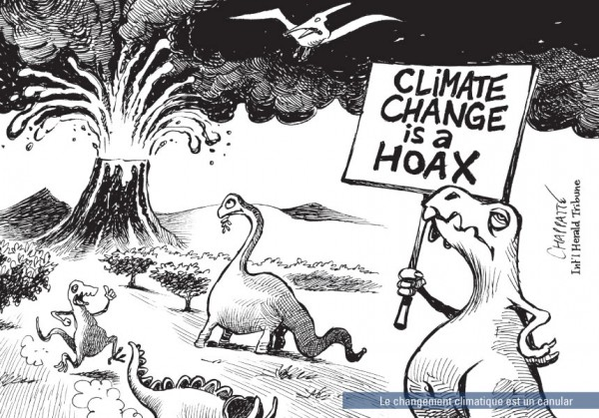
MAIN OBJECTIVE
To analyze variations in NDVI and EVI over the span of 20 years (2000 - 2020)
To forecast NDVI and EVI in upcoming year for Bangalore, Chennai, Delhi, Mumbai.
To answer the question “Is Climate change a myth?” based inferences made.

Slide 6
TOOLS
IDE – Jupyter Notebook, Google Code Editor
Python, JavaScript
Libraries – pandas, sklearn, tensorflow
EDA – matplotlib, seaborn, geopandas
ML models – Regression, SVM, ANN, Decision Tree, Random Forest, XGBoost, CatBoost

Slide 7
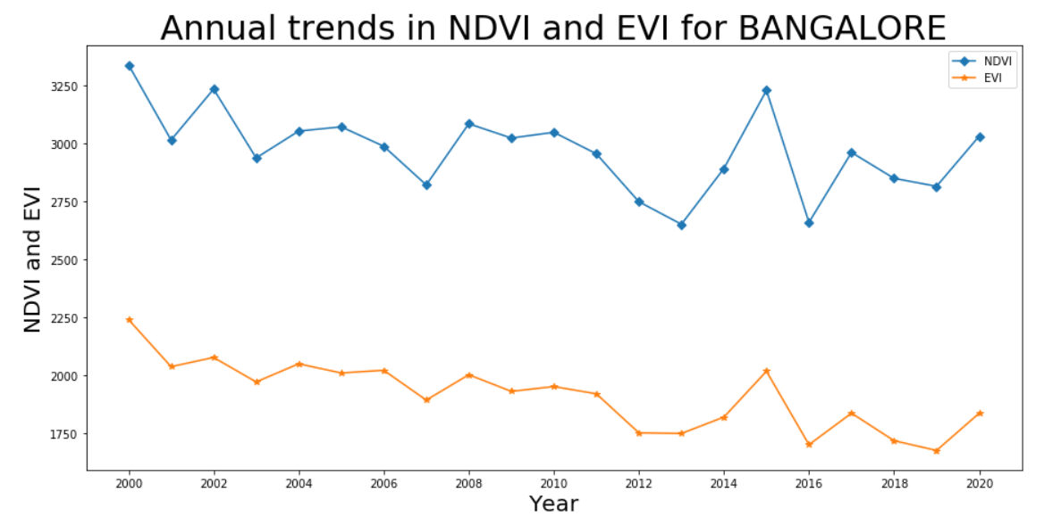
RESULTS
BANGALORE
This graph illustrates the yearly trend of vegetative index in Bangalore from 2000 to 2020.
As we can see there is decrease in the vegetative index in 2020 when compared from 2000.
There is a sudden decrease in 2015 due to the exploitation of green lands by the industries.
In 2014, a study revealed that 'Silicon valley of India' aka Bangalore has only 1 tree for every 7 persons.

Slide 8
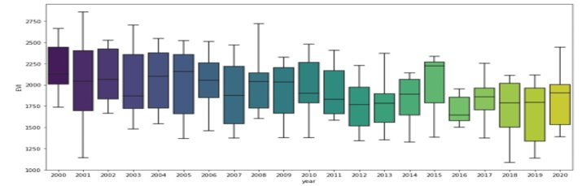
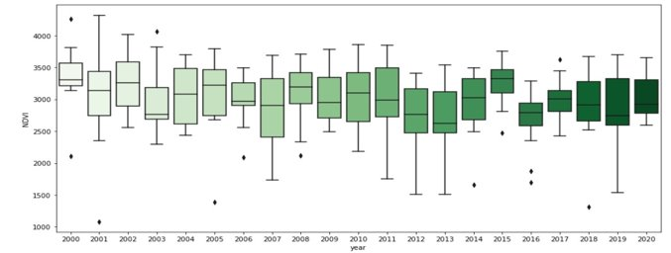

Slide 9
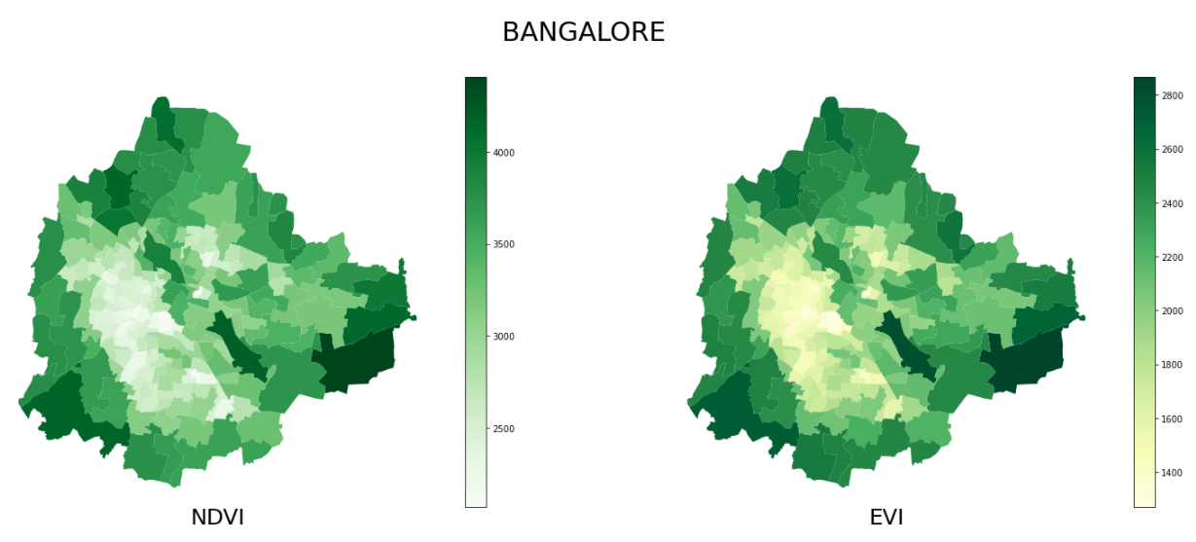
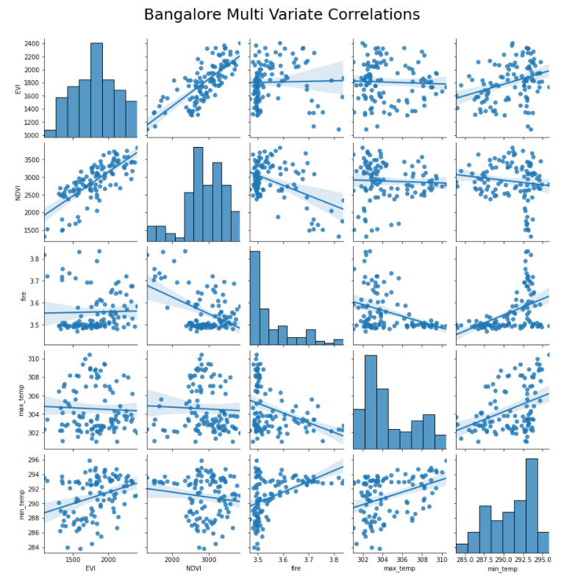
Fire value is strongly related to NDVI (inversely correlated) and min_temp(positively correlated) of the location.
But EVI is very weakly related to Fire, min_temp, max_temp values.
Values of EVI and NDVI are directly proportional to each other.

Slide 10
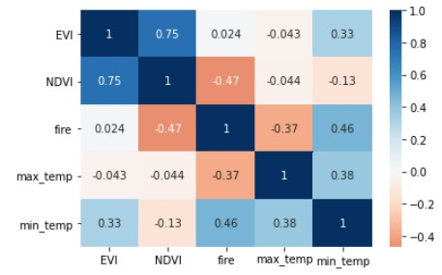
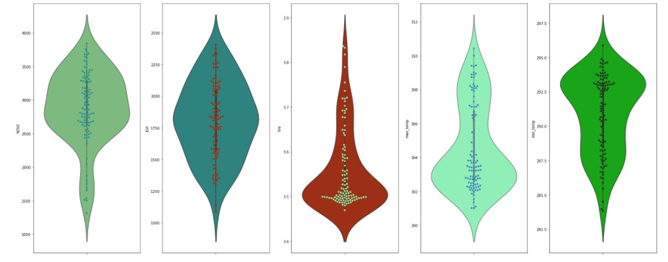

Slide 11
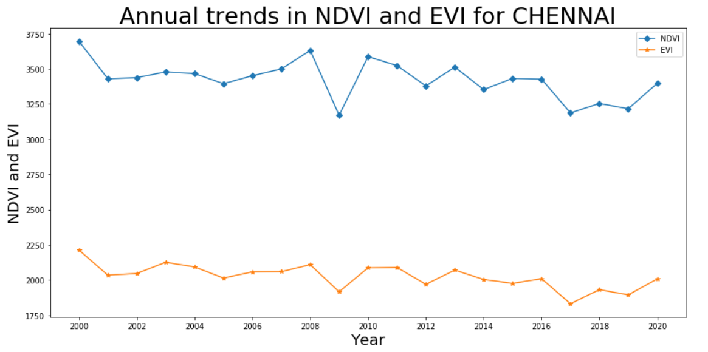
CHENNAI
There is less variability in vegetation index in general( for Chennai), possible reason is it being a coastal city
There is a huge dip in NDVI,EVI in the year 2009 can be considered as an after effect of Cyclone Nisha(November 2008), due to which vegetation was washed away

Slide 12
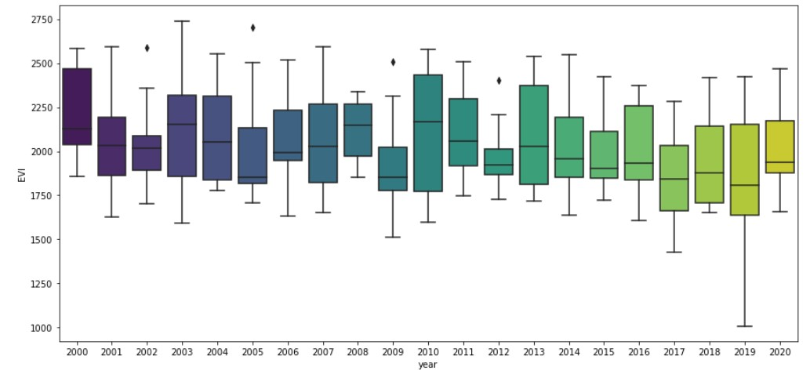
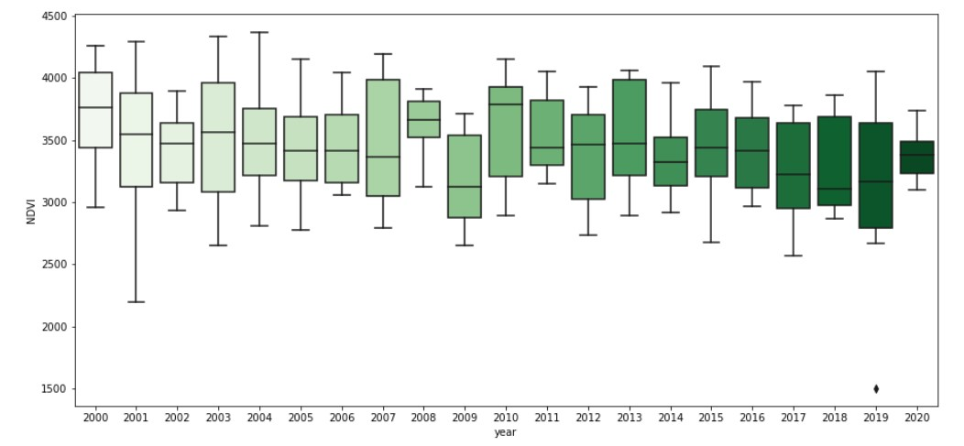

Slide 13
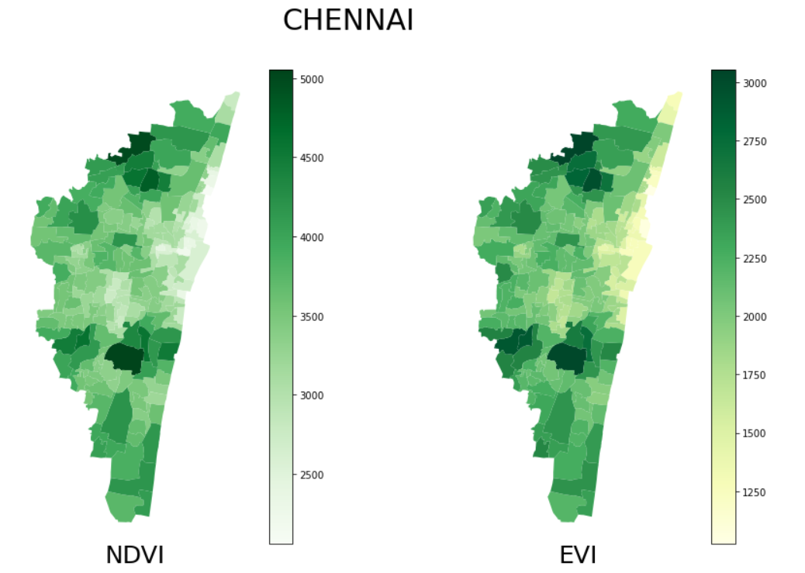
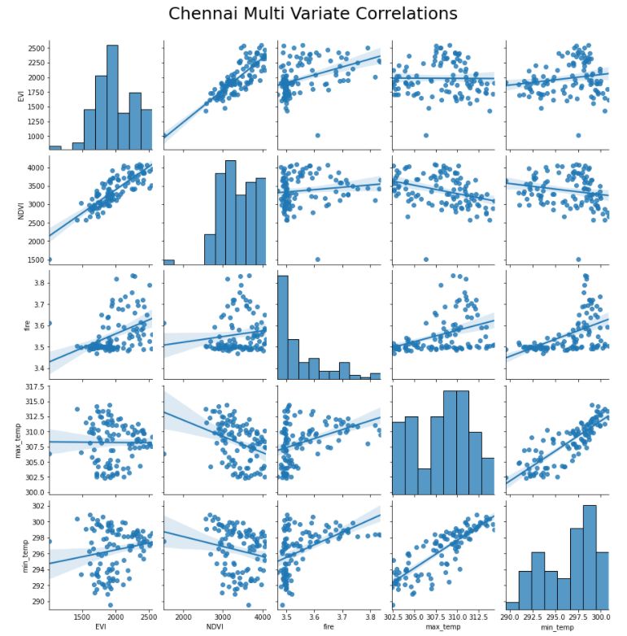
Fire value is strongly related to EVI(positively correlated) and min_temp(positively correlated) of the location.
But NDVI is very weakly related to Fire, min_temp, max_temp values.
Values of EVI and NDVI are directly proportional to each other.

Slide 14
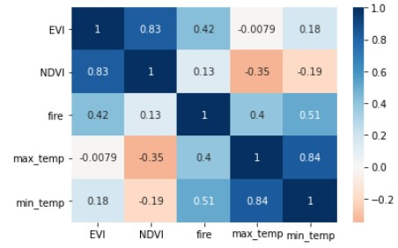
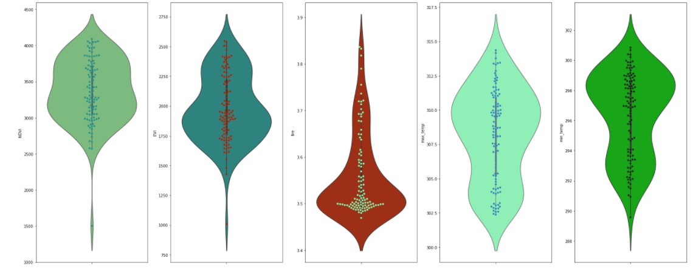

Slide 15
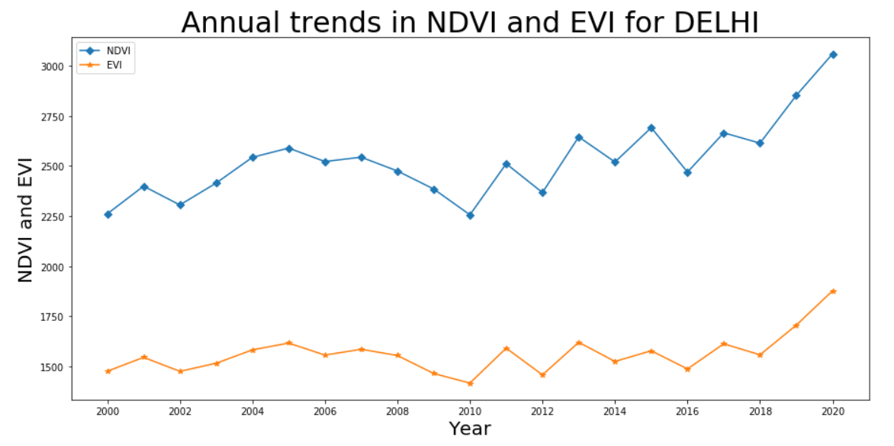
DELHI
The dip in vegetation in 2010 majorly due to Northern Hemisphere heat waves which recorded one of the highest temperatures in India cause from El Niño event
Major increase of vegatation began in 2018 can be accounted due to many mega plantation drives launched with the help of DDA in order to fight the high air pollution in Delhi

Slide 16
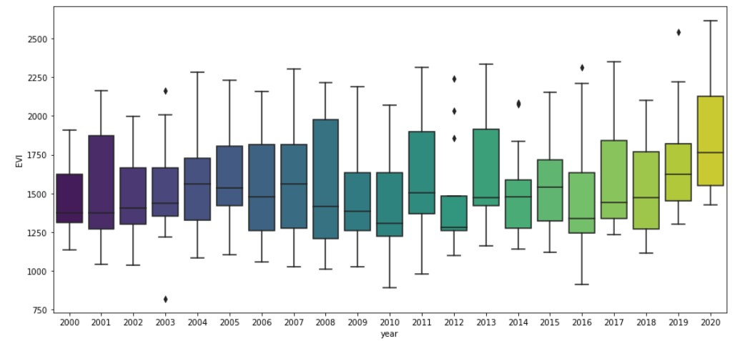
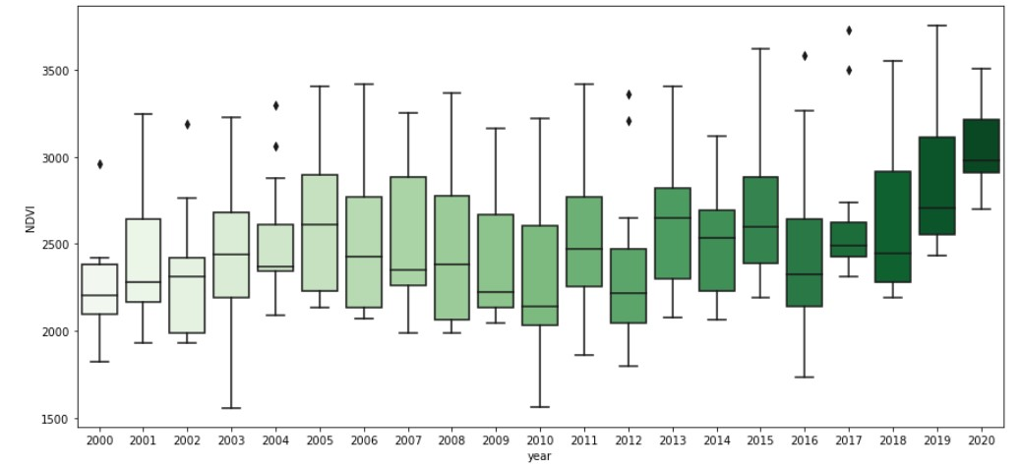

Slide 17
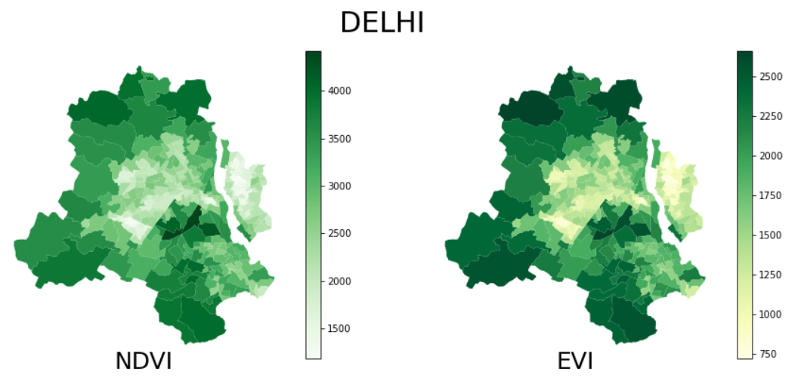
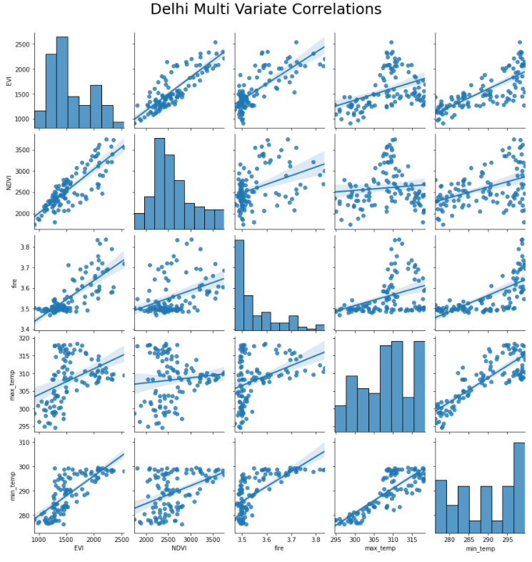
Fire value is strongly related to EVI(postively correlated) and min_temp(positively correlated) of the location.
But NDVI is very weakly related to Fire, min_temp, max_temp values.
min_temp has a strong positive correlation to EVI.
Values of EVI and NDVI are directly proportional to each other.

Slide 18
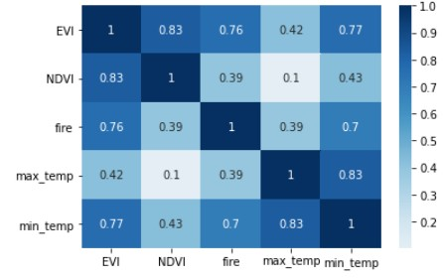
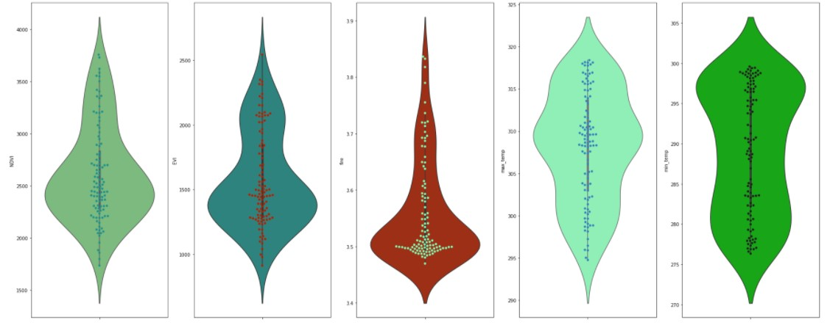

Slide 19
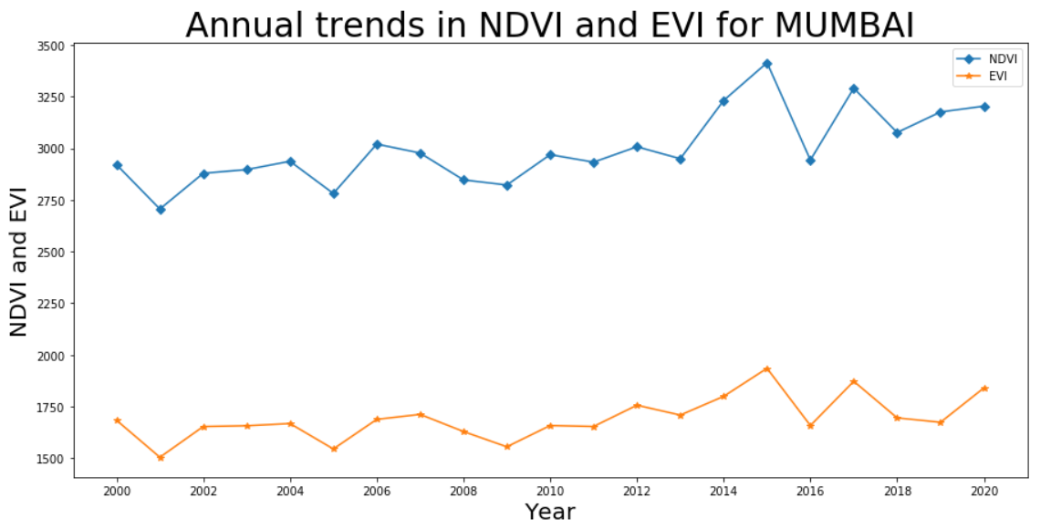
MUMBAI
There is less variability in vegetation index in general( for Mumbai), possible reason is it being a coastal city and also majorly because of protection of Sanjay Gandhi National Park
Decrease in the vegetation in 2005 is due to Mumbai floods(July 2005)
The major dip in the plot around 2016 could be due to ever increasing urbanization of the city

Slide 20
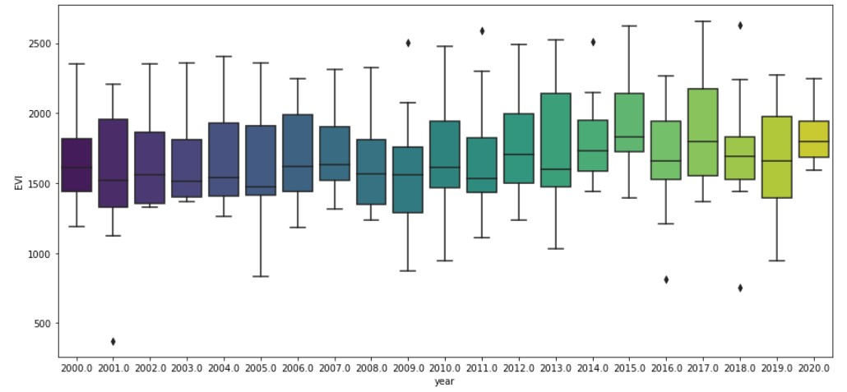
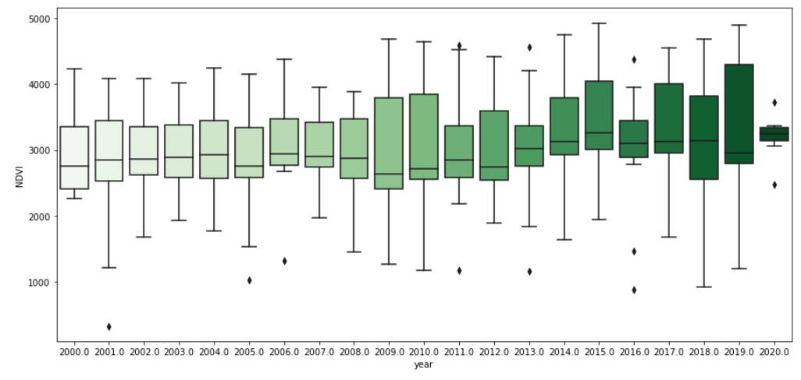

Slide 21
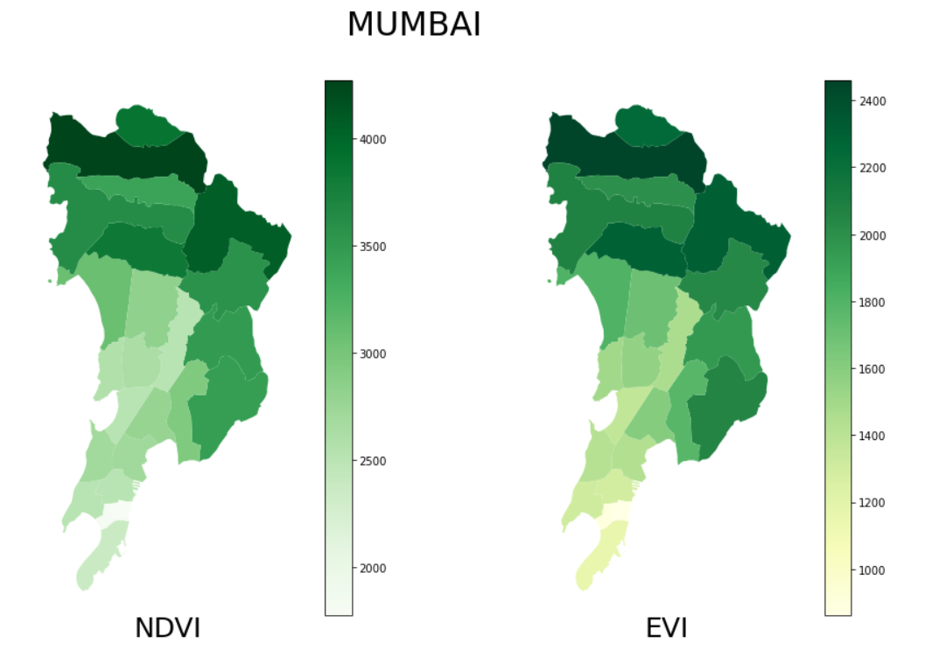
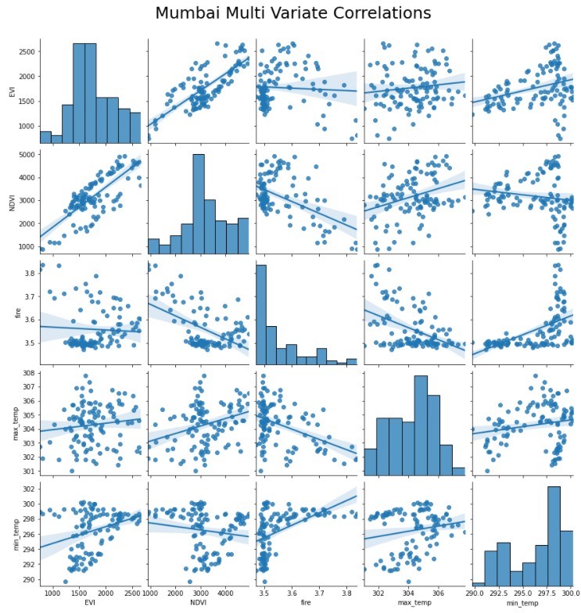
Fire value almost doesn't effect EVI.
NDVI is strongly weakly related to Fire values.
Values of EVI and NDVI are directly proportional to each other.

Slide 22
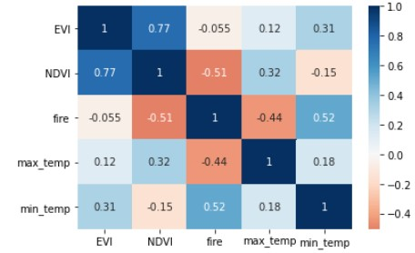
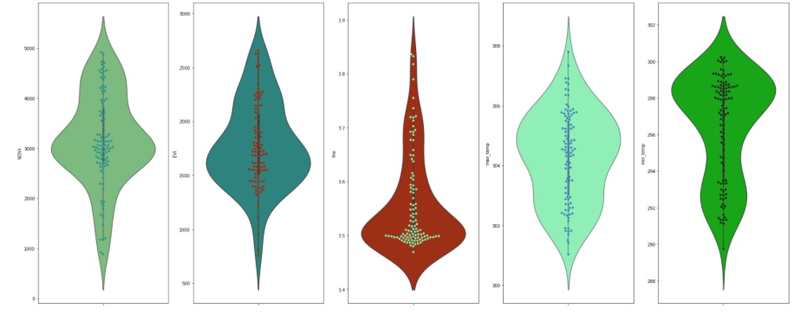

Slide 23
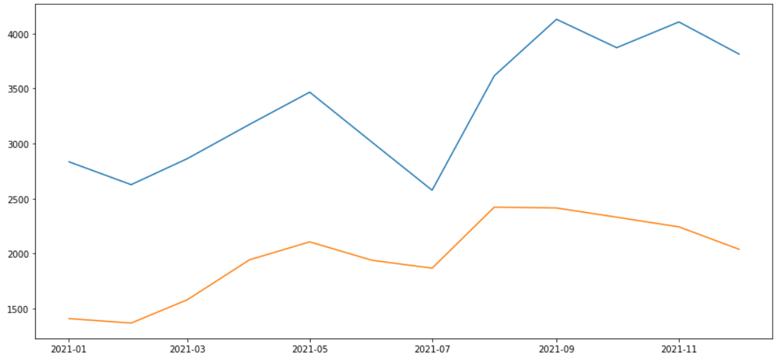
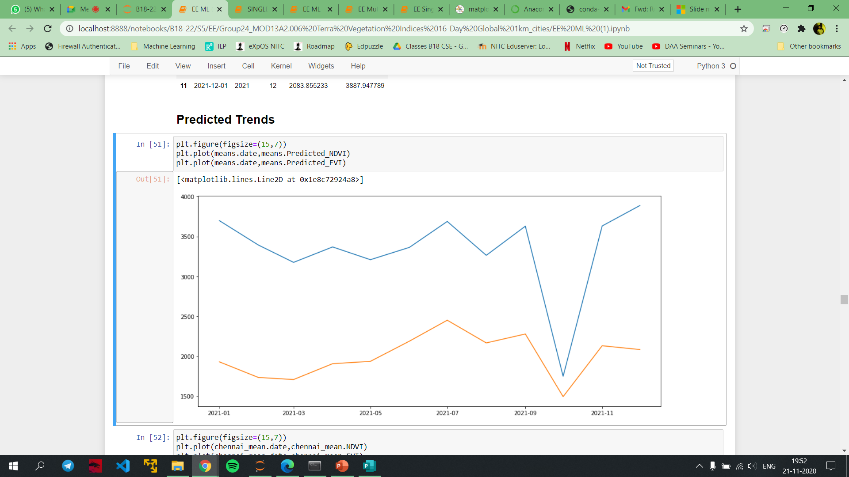
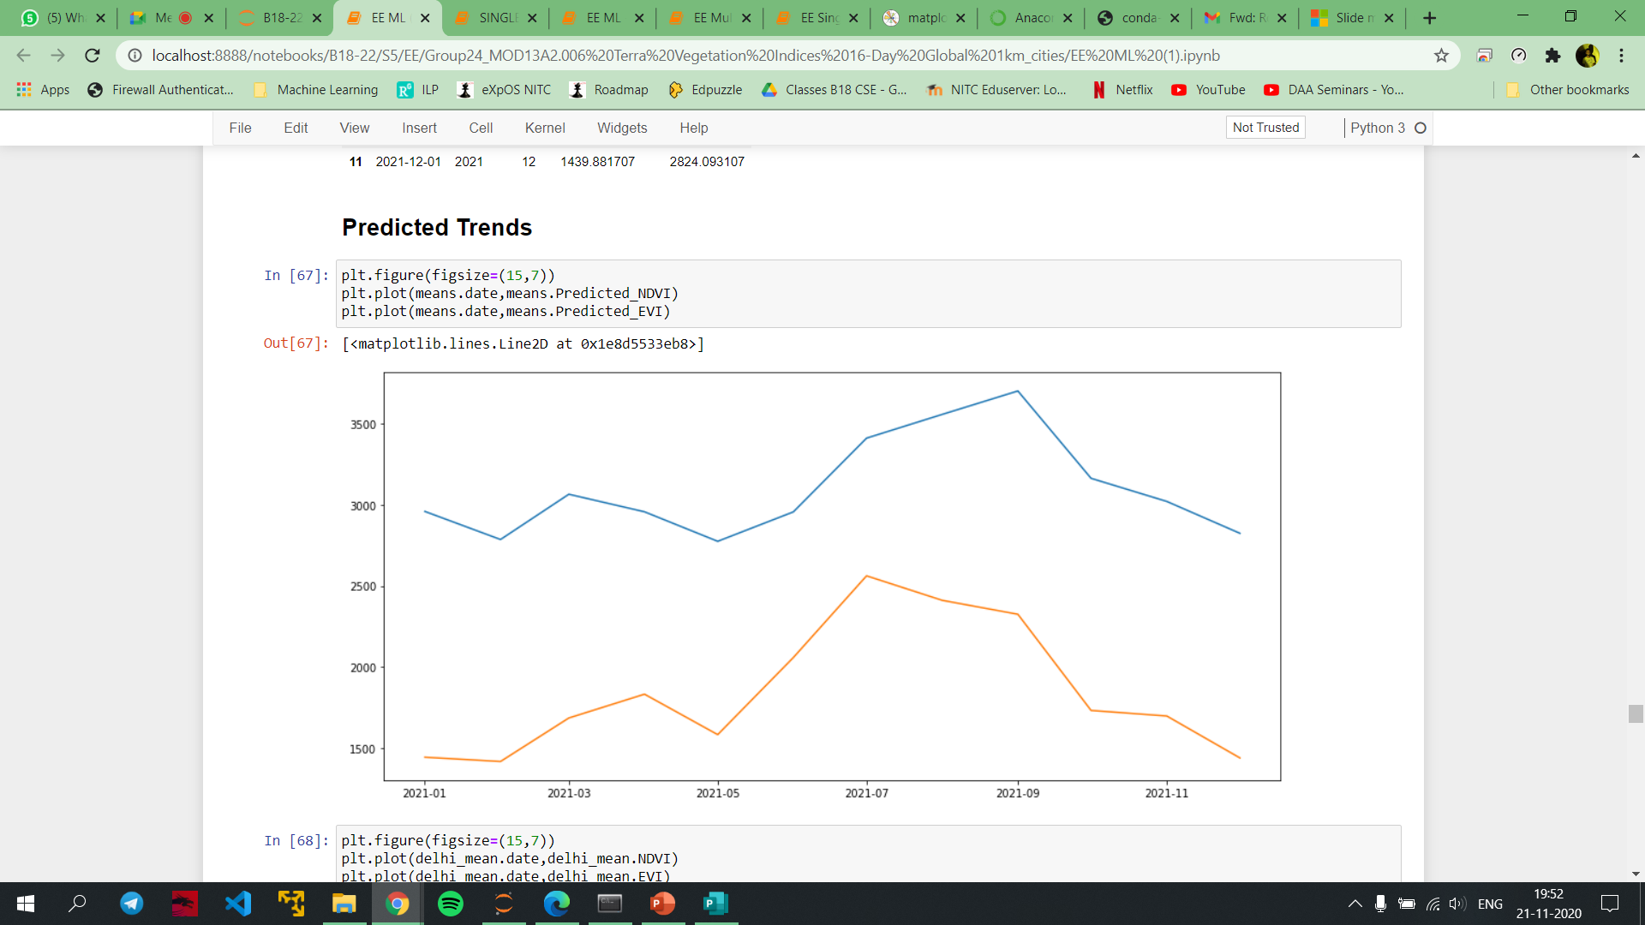
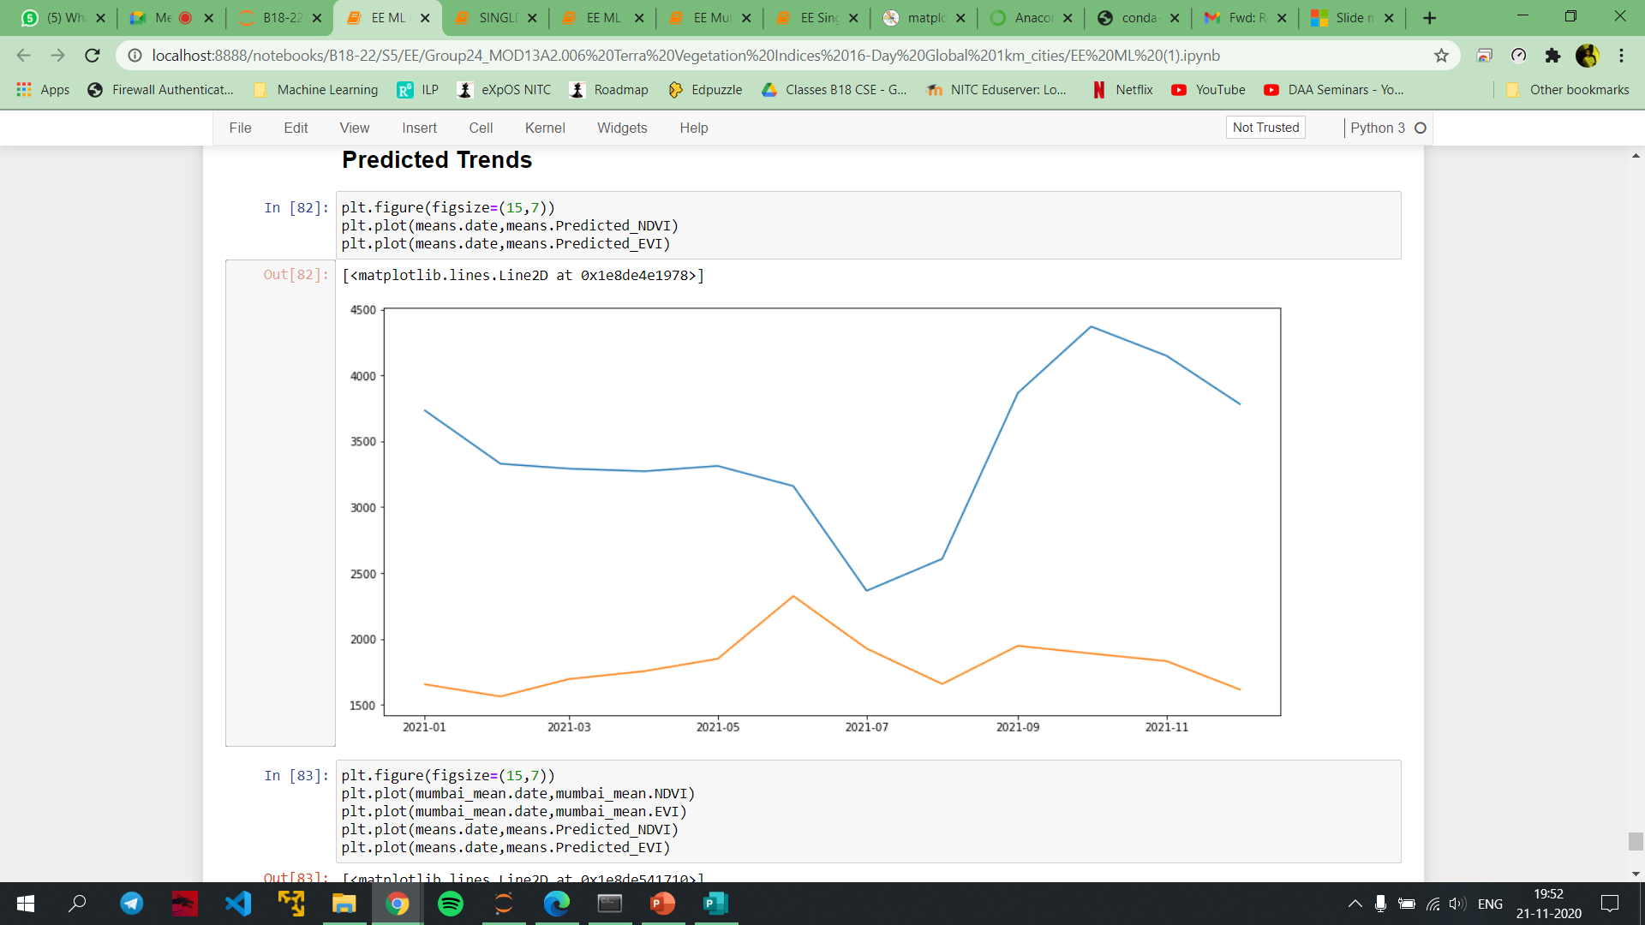
MUMBAI
P
R
E
D
I
C
T
I
O
N
S
BANGALORE
DELHI
CHENNAI

Slide 24
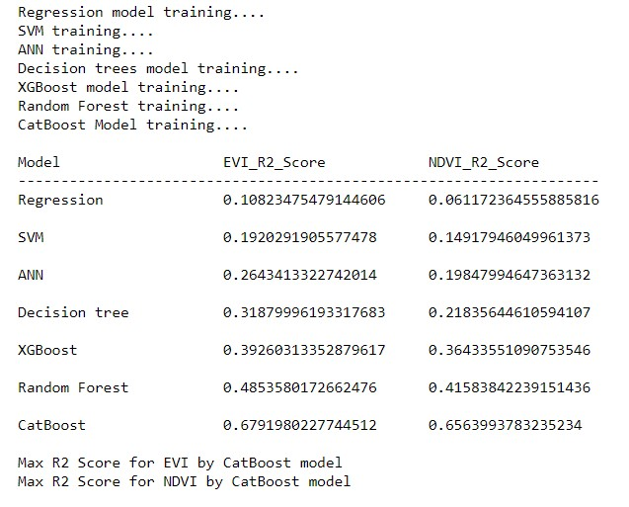
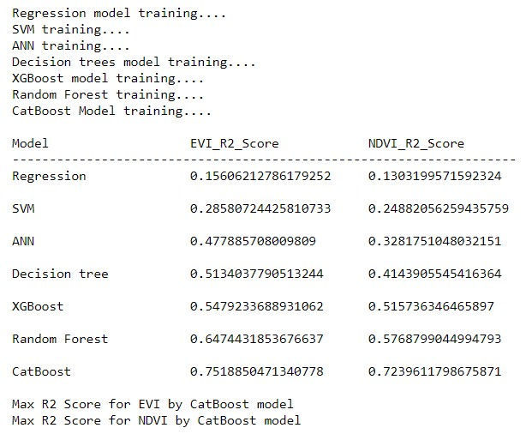
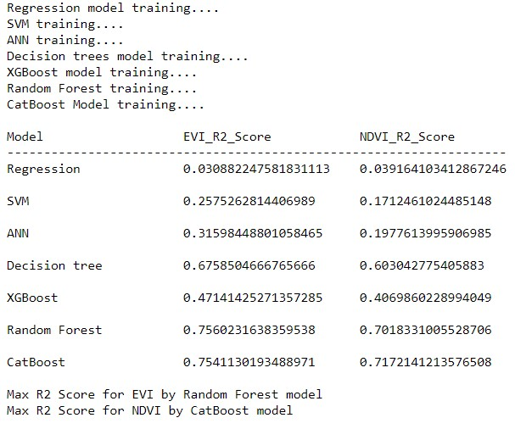
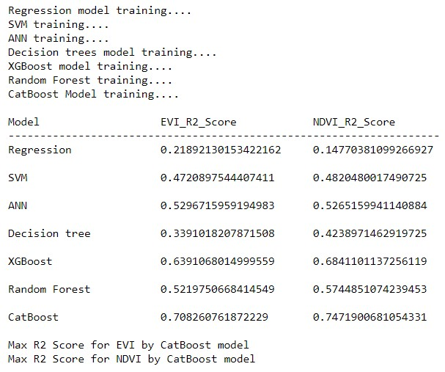
MUMBAI
P
R
E
D
I
C
T
I
O
N
S
BANGALORE
DELHI
CHENNAI

Slide 25
Effect of Climate change on Vegetation
The effect of climate change on vegetation is expected due to changes in the temperature, rainfall, and climate pattern as a result of which nutrient cycles, microbial activities, as well as physiological activities of plants will vary.
Changes in precipitation may change moisture regimes. Soil erosion, salinity, acidity, and other physical and chemical factors may be affected as well. All these factors are closely related to vegetation growth.
For example, with global temperature projected to rise to 3°C by the year 2030, this could cause the height of the sea level to rise by 0.8–1.8 m over the next century mainly due to thermal expansion of water and the melting of glaciers.
A 1-m rise in sea level could jeopardize one-third of the world’s cropland either through direct flooding or through salt water intrusion and would enhance the emission of greenhouse gases further.

Slide 26
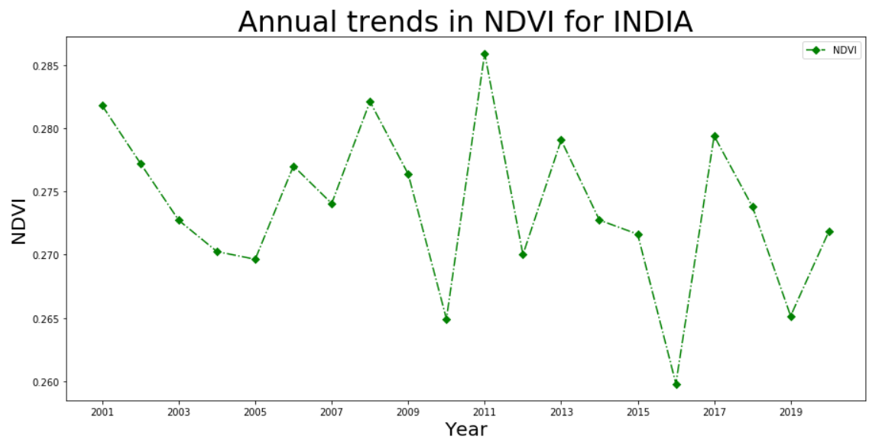
From ANNUAL NDVI graph for INDIA, from the decreased values of NDVI, it is clearly evident that Vegetation of INDIA has taken a worse hit

Slide 27
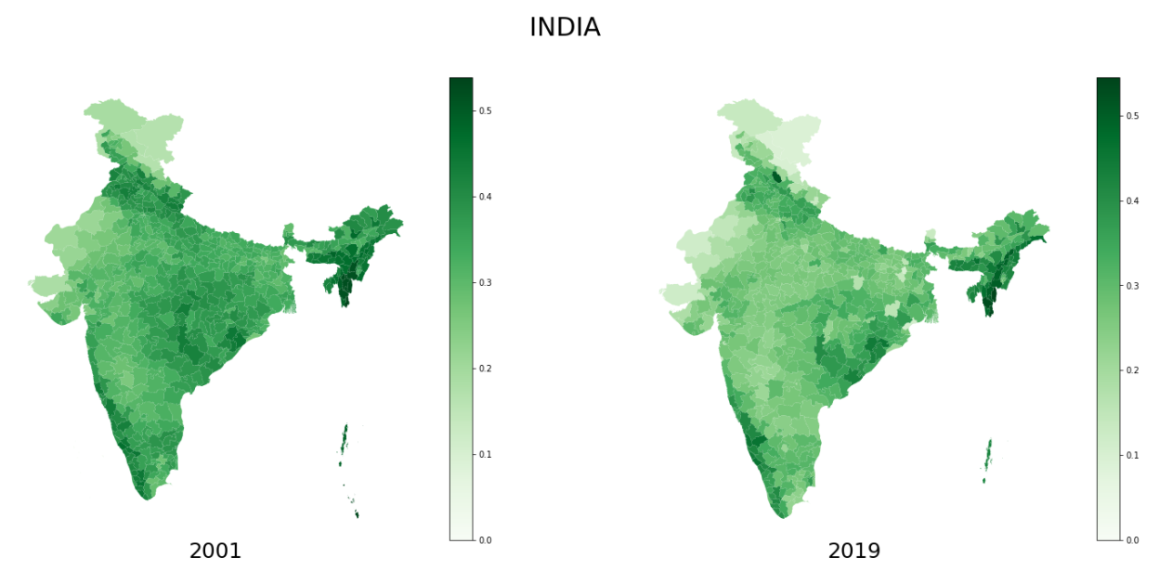

Slide 28
CONCLUSIONS
We can clearly see the decrease in greenery from previous choropleth map of India.
We can also infer that there is a dip in NDVI and EVI values from graphical analysis of each city.
We have studied how climate change effects green vegetation and with decrease in vegetation we can conclude that Climate change is for real.
Climate change is not a myth!!!!!

Slide 29
REFERENCES
https://eos.com/blog/ndvi-faq-all-you-need-to-know-about-ndvi/#:~:text=In%20most%20cases%2C%20NDVI%20values,possible%20density%20of%20green%20leaves
https://eos.com/blog/6-spectral-indexes-on-top-of-ndvi-to-make-your-vegetation-analysis-complete/
https://link.springer.com/chapter/10.1007/978-94-007-5370-9_4

Slide 30
THANK YOU!
S Sai Bala Subrahmanyam B180522CS
Ambati Vasanth Kumar Reddy B180289CS
Govindu C J V S Kasyap B180509CS
Martha Sai Krishna B180258CS
M P Harshavardhan B180222CS

